Slide 1

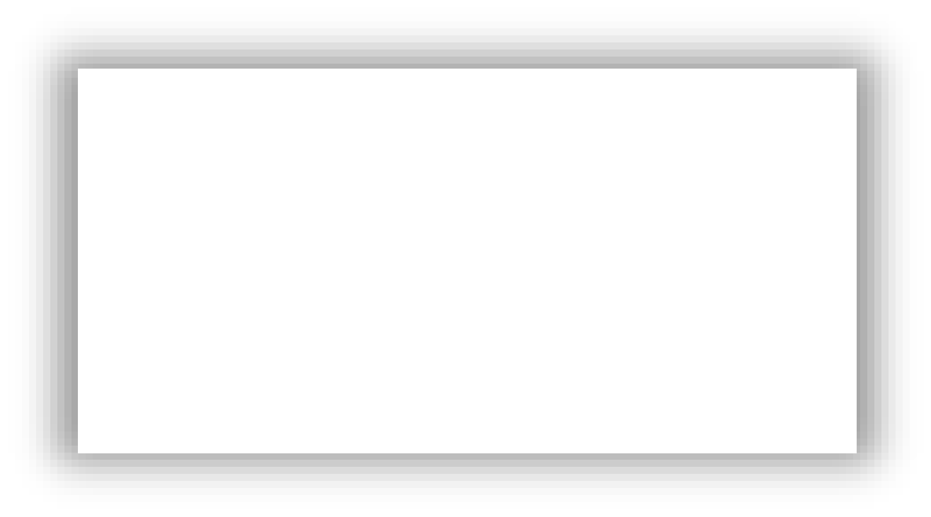



NEXT GEN EMPLOYABILITY PROGRAM
Creating a future-ready workforce
Team Members
College Name
Student Name SNEHA SRI.U
KINGSTON ENGINEERING COLLEGE
Student ID :511321104093

Slide 2

CAPSTONE PROJECT SHOWCASE
Next Gen Employability Program
Project Title
Building Bus Reservation System using Python and Django
Abstract | Problem Statement | Project Overview | Proposed Solution | Technology Used | Modelling & Results | Conclusion

Slide 3
Next Gen Employability Program
Abstract
In today's fast-paced world, efficient transportation systems are crucial for facilitating smooth travel experiences. This abstract outlines the development of a Bus Reservation System using Python and Django, aimed at streamlining the process of booking bus tickets for passengers.
It is developed using the Django framework, a high-level Python web framework.
The development process will follow best practices in software engineering, including modular design, code reusability, and adherence to the Model-View-Controller (MVC) architectural pattern.
The proposed Bus Reservation System aims to provide a seamless booking experience for passengers while offering administrators a comprehensive platform for managing bus operations effectively. By harnessing the power of Python and Django, the system endeavors to contribute to the optimization of transportation services in the digital age.
Source :

Slide 4
Next Gen Employability Program
Problem Statement
In today's transportation landscape, there exists a notable gap in the efficiency and convenience of bus ticket booking systems. Traditional methods often involve long queues, manual processes, and limited accessibility, leading to inconvenience for passengers and inefficiencies for bus operators. To address these challenges, the development of a modern Bus Reservation System using Python and Django is proposed.
The primary problem to be addressed is the lack of a user-friendly, digital platform for
booking bus tickets.
Moreover, the absence of centralized management tools for bus operators can lead to logistical challenges in route planning, scheduling, and fare management.
Source :

Slide 5
Next Gen Employability Program
Project Overview
The Bus Reservation System project aims to develop a comprehensive web application using Python and Django to streamline the process of booking bus tickets for passengers while providing efficient management tools for bus operators.
Objectives:
Experience Enhance Passenger
Optimize bus operation
Ensure Scalability and Security
Key features:
User Authentication and Registration
Bus Route Management
Schedule Management 4.Seat Selection and Booking 5.Payment Integration
Technologies: _{1.Python}
2.Django
HTML/CSS/JAVASCRIPT
Source :

Slide 6
Next Gen Employability Program
Proposed Solution
Introduction:
The proposed solution entails the development of a robust Bus Reservation System using
Python and Django, aimed at providing passengers with a seamless booking experience and empowering bus operators with efficient management tools
Architecture:
The Bus Reservation System will follow a Model-View-Controller (MVC) architectural pattern, leveraging Django's built-in features for rapid development and clean code organization.
1.Model Layer:
Responsible for defining the data models and business logic of the application. This layer will
include models for buses, routes, schedules, seats, bookings, users, and administrative data.
Source :

Slide 7
Next Gen Employability Program
View Layer:
Handles the presentation logic and user interface components of the application. Views will be implemented using Django's template system to render dynamic HTML pages and respond to user interactions.
Controller Layer:
Manages the flow of requests and responses between the model and view layers. 3
Key Components and Functionalities:
1.User Authentication and Registration:
Users can register for an account or log in securely using email and password authentication.
2.Bus Route Management:
Administrators can add, edit, and delete bus routes, specifying details such as destinations, departure times, and fares.
Source :

Slide 8
Next Gen Employability Program
3.Seat Selection and Booking:
Passengers can browse available bus routes, view schedules, select seats from a graphical seat map, and
proceed to booking.
4.Payment Integration:
Integrated payment gateways such as Stripe or PayPal will facilitate secure online payments for ticket bookings.
Technologies: The proposed solution will utilize the following technologies:
Python: Backend development and business logic implementation.
Django: Web framework for rapid development, ORM, authentication, and URL routing.
HTML/CSS/JavaScript: Front-end development for user interface design and interactivity.
PostgreSQL: Database management system for storing application data securely.
* The proposed Bus Reservation System offers a comprehensive solution for streamlining bus ticket bookings
and management operations
Source :

Slide 9
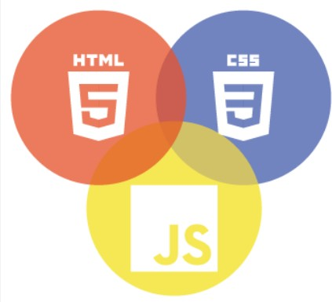

Next Gen Employability Program
Technology Used
Front-end
Back-end
Source :

Slide 10
Next Gen Employability Program
Modelling & Results
Database Model Design
Utilize Django's ORM to d: efine models for buses, routes, schedules, seats, bookings, and users.
User Interface Design
Design user-friendly in:terfaces using HTML, CSS, and JavaScript with responsiveness to ensure
compatibility across devices.
Authentication and Authorization
Implement user authentication and:registration functionality using Django's built-in authentication
system.
Bus Route Management
Include form validation to e:nforce data integrity and prevent invalid inputs.
Testing and Validation
Conduct unit tests to verify the functionality of individual components and integration tests to ensure seamless interaction betw: een modules.
Results:
-Improved user experience
-Scalability and flexibility
Source :

Slide 11
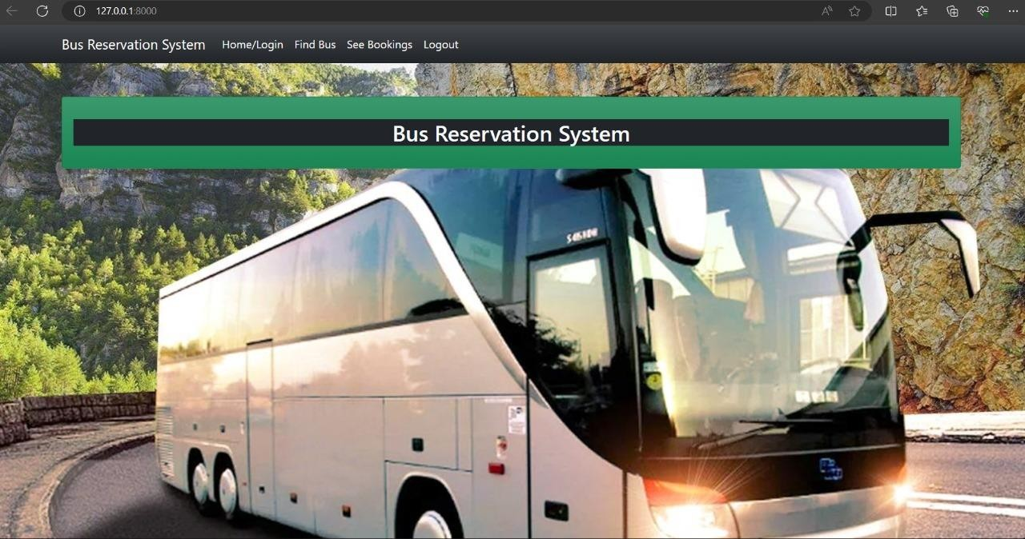
Homepage
Next Gen Employability Program

Slide 12
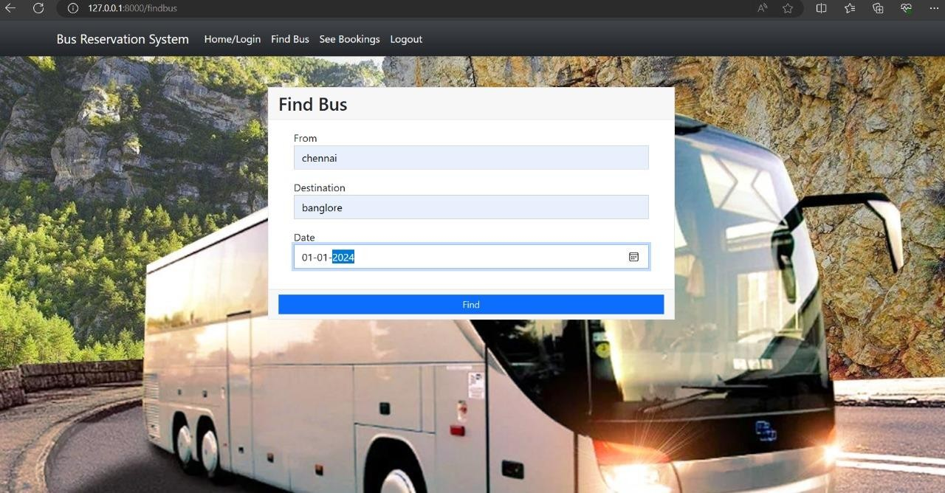
Next Gen Employability Program
About-Us-Page

Slide 13
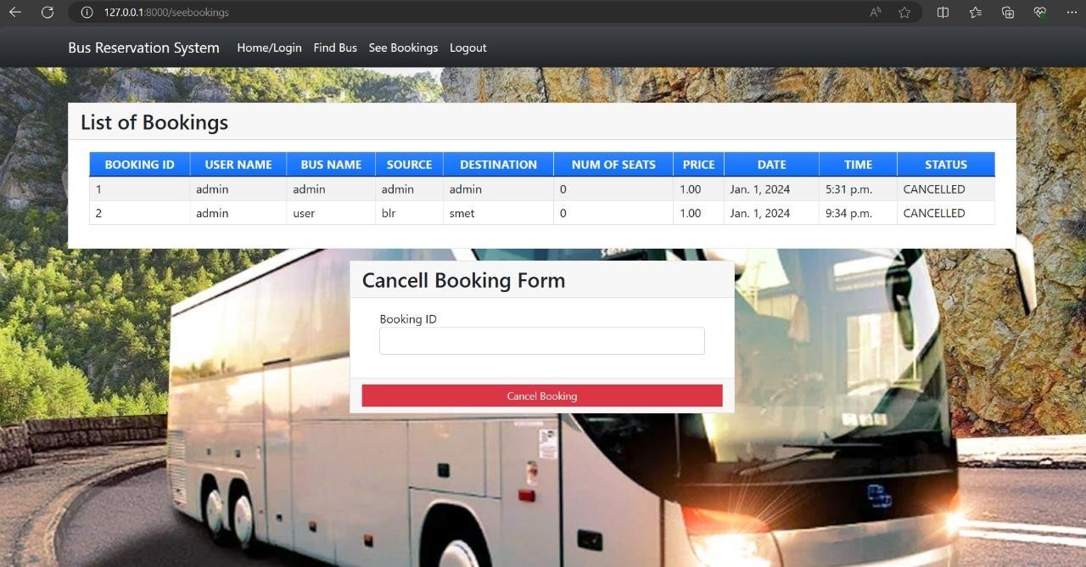
Next Gen Employability Program
Service-Page

Slide 14
Next Gen Employability Program
Departments-Page

Slide 15
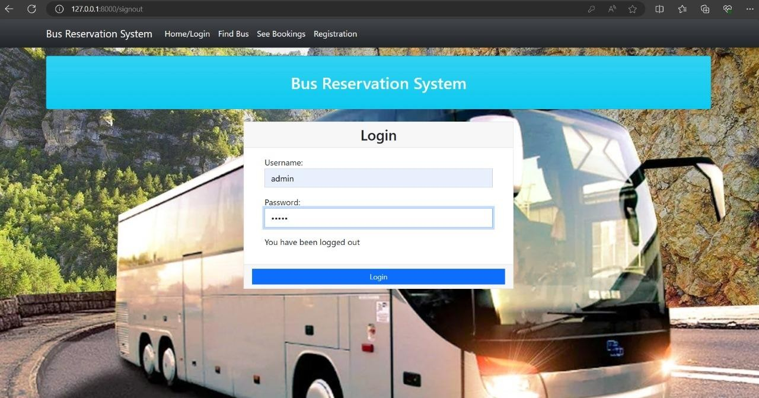
Next Gen Employability Program
Blog-Page

Slide 16
Next Gen Employability Program
Future Enhancements:
While the initial development of the Bus Reservation System using Python and Django will address the core requirements, there are several opportunities for future enhancement and expansion.
Mobile Application Development:
-Develop native mobile applications for iOS and Android platforms to provide a more convenient booking
experience for users on mobile devices.
Dynamic Pricing and Discounts:
Introduce dynamic pricing algorithms based on factors such as demand, time of booking, and seat availability
to optimize revenue for bus operators
3.Geolocation and Mapping Integration:
Incorporate geolocation features to enable users to search for nearby bus stops, view route maps, and get
directions to boarding points.
4.Accessibility Features:
Enhance accessibility by implementing features such as screen reader support, keyboard navigation, and
high-contrast themes to accommodate users with disabilities.

Slide 17
Next Gen Employability Program
Conclusion
In conclusion, the development of a Bus Reservation System using Python and Django represents a significant step towards modernizing and optimizing the process of booking bus tickets for passengers and managing bus operations for operators.
The system is designed to handle a growing user base and maintain data security through measures such as input validation, encryption, and protection against common security threats.
The Bus Reservation System has significant potential for future enhancements, including mobile application development, dynamic pricing, integration with transportation networks, accessibility features, and advanced analytics.
The Bus Reservation System serves as a testament to the power of Python and Django in
developing sophisticated web applications that address complex business needs
Source :

Slide 18
Thank You!
Next Gen Employability Program

